Slide 1



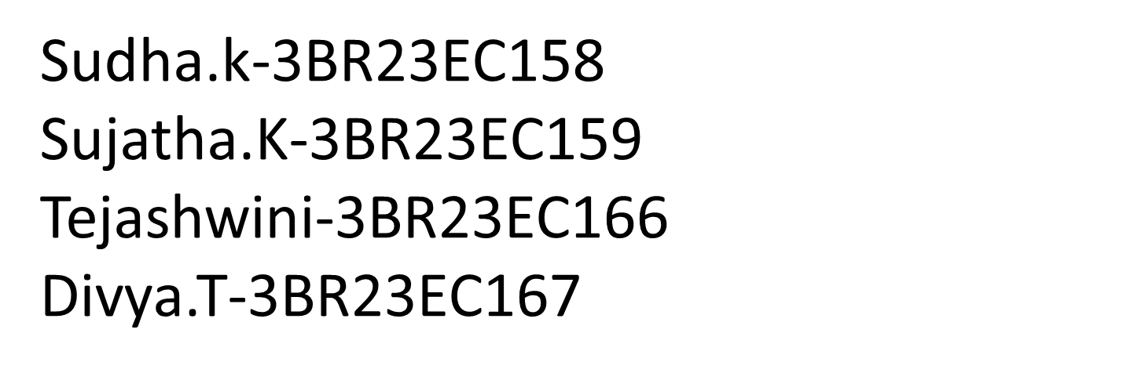
VIRTUAL TICKETING SYSTEM
class

Slide 2

INTRODUCTION
A Virtual Ticketing System is a Digital Platform that enables users to purchase, manage, and access tickets for events , transportation , or services in a conveninent , secure, and efficient manner . This System eliminates the needed for physical tickets , reducing costs and minimizing the environmental impact associated with printing and distribution.

Slide 3


PROBLEM STATEMENT
Mobile Access
Secure & Scalable
Attendees can conveniently access their tickets on their smartphones, eliminating the need for physical tickets.
Virtual ticketing platforms are designed to handle large volumes of tickets, ensuring security and scalability.
Real-Time Analytics
Data on ticket sales, attendance, and customer behavior can be accessed in real-time, providing valuable insights.

Slide 4
OBJECTIVES
Personalized Ticket Design
Website
Marketing Materials
Create custom ticket designs that reflect your event's branding and theme.
Host your ticketing website with your brand's design and colors, enhancing customer experience.
Promote your event with branded marketing materials, such as social media graphics and email templates.

Slide 5
ALGORITHM
1
CLASSES – Ticket to represent individual tickets.
Ticket Manager to handle operations related to the tickets such as CRUD operations , sales , and validations
2
OPERATIONS - CRUD (Create , Read , Update , Delete) operations for ticket data.
Handling of online ticket sales.
3
DATA HANDLING – To keep it simple , tickets will be stored in a dictionary keyed by ‘ticket_id’

Slide 6






Seamless Integration
Event Management Platforms
Integrate with popular event management platforms for a streamlined workflow.
Payment Gateways
Connect with secure payment gateways for easy and secure ticket purchases.
Marketing Automation Tools
Integrate with marketing automation tools for targeted email campaigns and promotions.

Slide 7
FLOW CHART
[Start]
|
v
[User Login?] -----> [Prompt for login] -----> [User Login]
| |
Yes No
| |
v v
[Dashboard] <-------------------
|
v
[Select: Submit/View/Generate/Logout]
|
v
[Submit Ticket] ---> [Validate Input?] -----> [Show Error] -----> [Prompt for Correction]
| |
| Yes
| |
v v
[Generate Ticket ID] [Return to Dashboard]
|
v
[Save Ticket] -----> [Display Confirmation] ---> [Return to Dashboard]

Slide 8
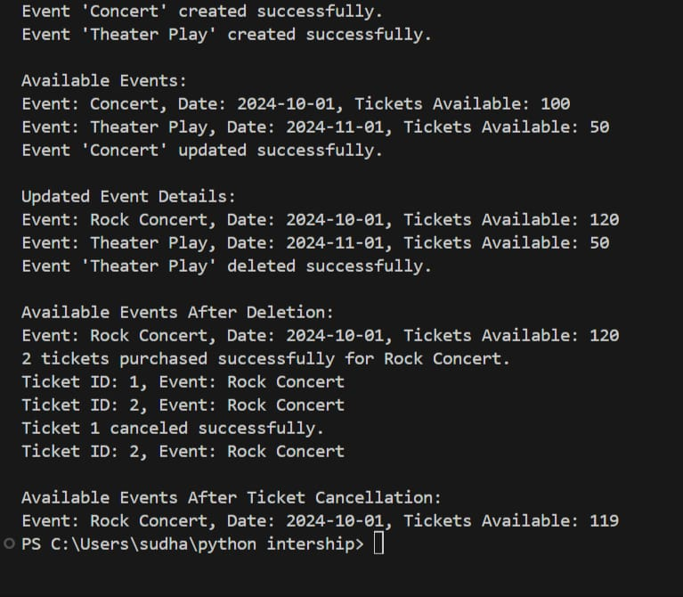
OUTPUT

Slide 9


CONCLUSION
Virtual ticketing offers a range of benefits for event organizers and attendees. Consider implementing a virtual ticketing system to enhance your event management and customer experience.
A virtual ticketing system significantly enhances user experience and operational efficiency by streamlining the processes of ticket submission, management, and resolution. This system allows users to easily submit tickets, track their status, and receive timely updates, leading to higher satisfaction rates. For support teams, it enables effective organization, prioritization, and management of tickets, ensuring prompt attention to issues. Additionally, the system generates valuable reports and analytics, providing insights that help organizations identify trends and improve service quality. With features like ticket assignment and user feedback, it fosters collaboration among team members, enhancing the overall resolution process. As businesses navigate a digital landscape, adopting a virtual ticketing system becomes essential for maintaining competitiveness and responsiveness to customer needs, ultimately contributing to a better service delivery.

Slide 10


